Slide 1

COVID-19 VACCINE MANAGEMENT SYSTEM
GROUP 12
DIMPLE SHOUNAK
KRISHNA MAYAVAT
SICHENG ZHOU
ROHITH KUMAR MANJUNATHA
BALAMURUGAN RAMAKRISHNAN

Slide 2
OBJECTIVE & DESIGN APPROACH
In the project, we have created a centralized database system to administrative vaccination drives.
Purpose: 1. To maintain a record of every single vaccine shot 2. To provide data support for the decision-making of vaccine management 3. To provide platform for data collection and information sharing on vaccine administration
Design Approach
Database requirement analysis : Collected relevant data about the vaccine drives being carried out to better understand the vaccine supply and manufacturing system
Database design : Used top-down design to develop a ERD model which includes the entities and relationships between vaccination centers , vaccine suppliers ,vendors etc
Database Implementation : DDLs , DMLs , stored procedures ,triggers etc
Database Maintenance : Created a dashboard report to improve efficiency of the database system and GUI to perform the CRUD operations on the customer and the vaccine record table

Slide 3
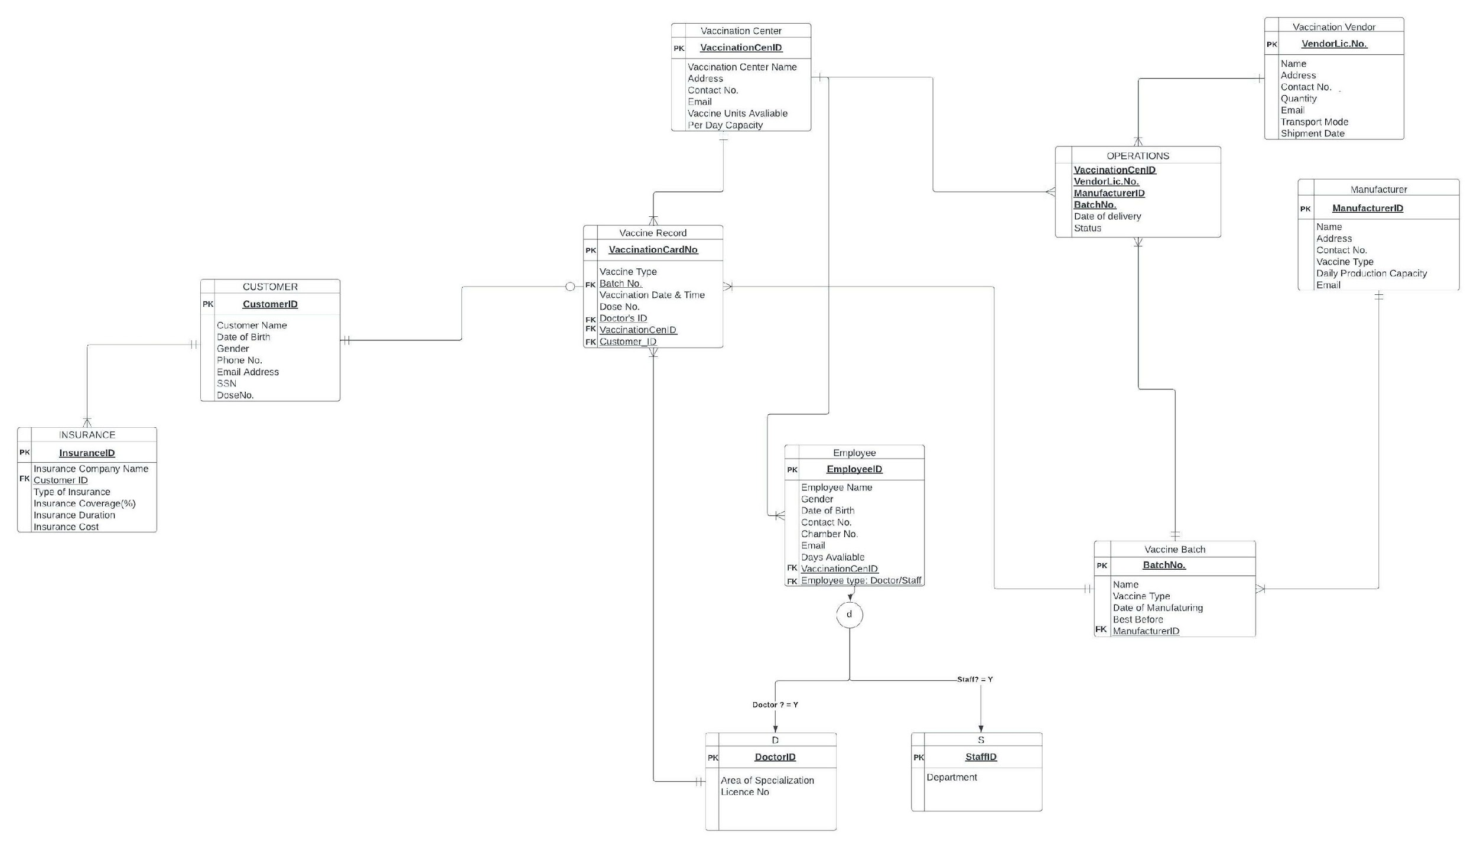
ERD
CUSTOMER FOCUSED
FACILITY FOCUSED
OPERATIONS FOCUSED

Slide 4
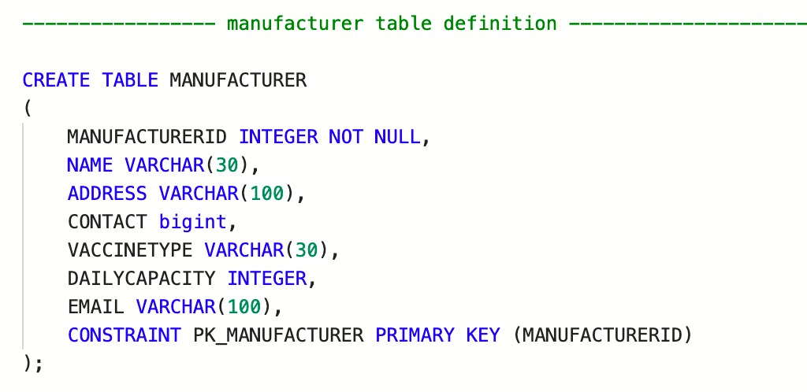
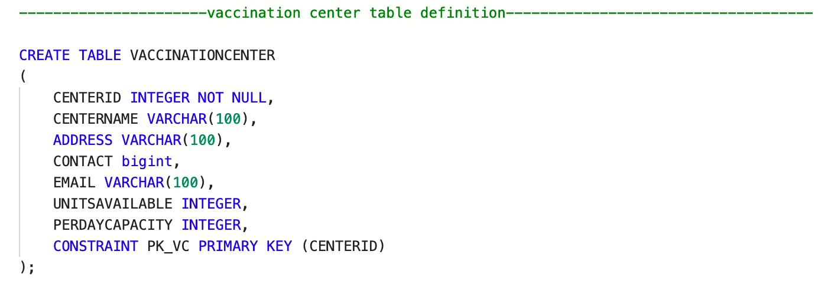
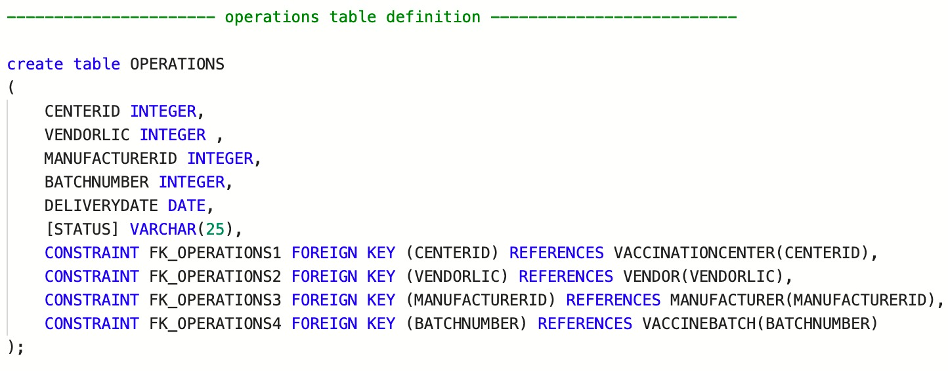
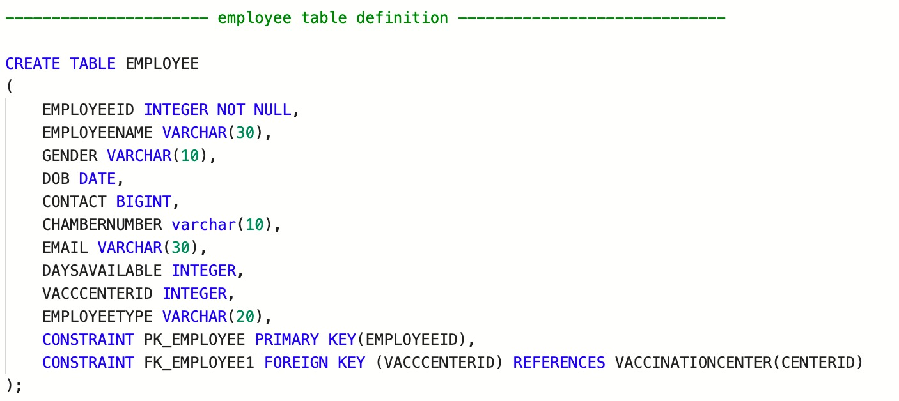
DDL

Slide 5
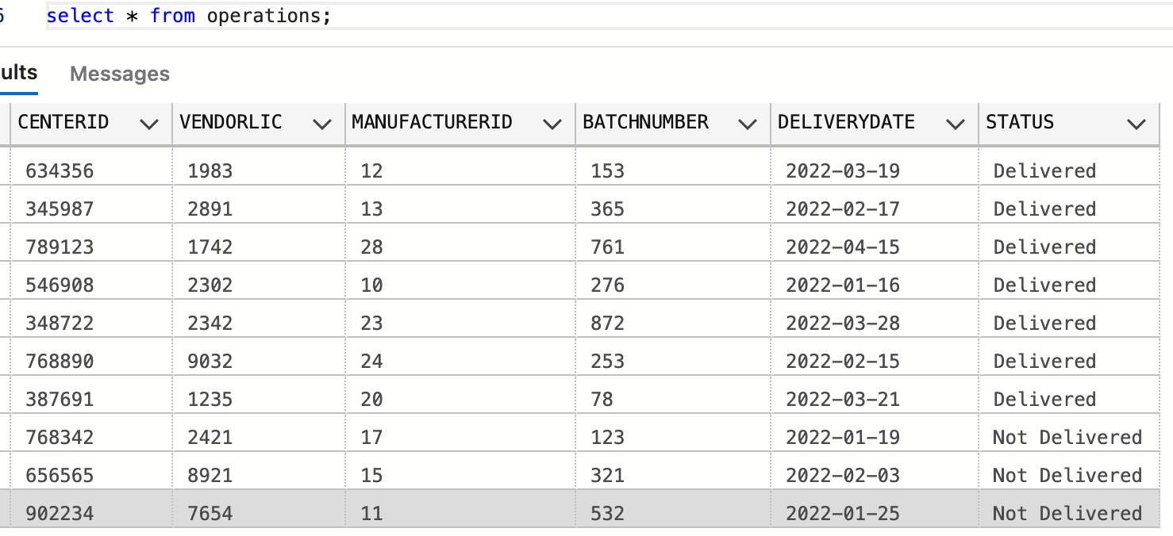
INSERT INTO VACCINATIONCENTER(CENTERID, CENTERNAME, ADDRESS, CONTACT, EMAIL, UNITSAVAILABLE, PERDAYCAPACITY) VALUES(634356, 'RCS' , '14 stuu street, 02123, Boston, MA’, 8505563700, 'rcs@gmail.com', 1000, 40 );
INSERT INTO VENDOR(VENDORLIC, Name, Address, CONTACT, Quantity, Email, TRANSPORTMODE,SHIPMENTDATE) Values (1983,'GFU','253 Elizabeth Road, Boston, MA, 02115',8374392028,5500,'GFU@gmail.com','Ground','2022-03-05') ;
INSERT INTO Manufacturer (ManufacturerID, Name, Address, CONTACT ,VACCINETYPE ,DAILYCAPACITY, Email) Values (12,'BTH','231 Maple Road, Boston, MA, 05233',8731239304,'Pfizer',2000,'BTH@gmail.com') ;
INSERT INTO CUSTOMER (CUSTOMERID, CUSTOMERNAME, DOB, GENDER, CONTACT, EMAIL, SSN, DOSENUMBER) VALUES(11002, 'Ajay Jadeja', '1989-05-13', 'Male', 5712349980, 'jadeja.ajay@gmail.com', 1234567890, 1);
INSERT INTO INSURANCE(INSURANCEID, COMPANYNAME, CUSTOMERID, INSURANCETYPE, INSURANCECOVERAGE, INSURANCEDURATION, INSURANCECOST) VALUES(128, 'AB Health Corp', 11002, 'Health', 70, 12, 35000);
INSERT INTO EMPLOYEE (EMPLOYEEID,EMPLOYEENAME,GENDER,DOB,CONTACT,CHAMBERNUMBER,EMAIL,DAYSAVAILABLE,VACCCENTERID,EMPLOYEETYPE) VALUES (101,'Alice Lu','Female','1990-05-23',6272390125,'DW','Alice1990@gmail.com',3,634356,'Doctor');
INSERT INTO VACCINEBATCH (BATCHNUMBER,NAME,VACCINETYPE,MANUFACTUREDATE,USEBEFORE,MANUFACTURERID) VALUES (153,'Pfizer153','Pfizer','2022-03-01','2022-12-01',12);
INSERT INTO OPERATIONS (CENTERID,VENDORLIC,MANUFACTURERID,BATCHNUMBER,DELIVERYDATE,[status]) VALUES (634356,1983,12,153,'2022-03-19','Delivered');
INSERT INTO DOCTOR (DOCTORID,SPECIALIZATION,DOCTORLICNO) VALUES (102,'Allery and immunology',356);
INSERT INTO VACCINERECORD(VACCCARDNUMBER, VACCINETYPE, BATCHNUMBER, VACCDATE, DOSENUMBER, DOCTORID, CENTERID,CUSTOMERID) VALUES(12, 'Pfizer’, '153’, '2021-06-20’, 1,101, 634356, 11002);
DML

Slide 6
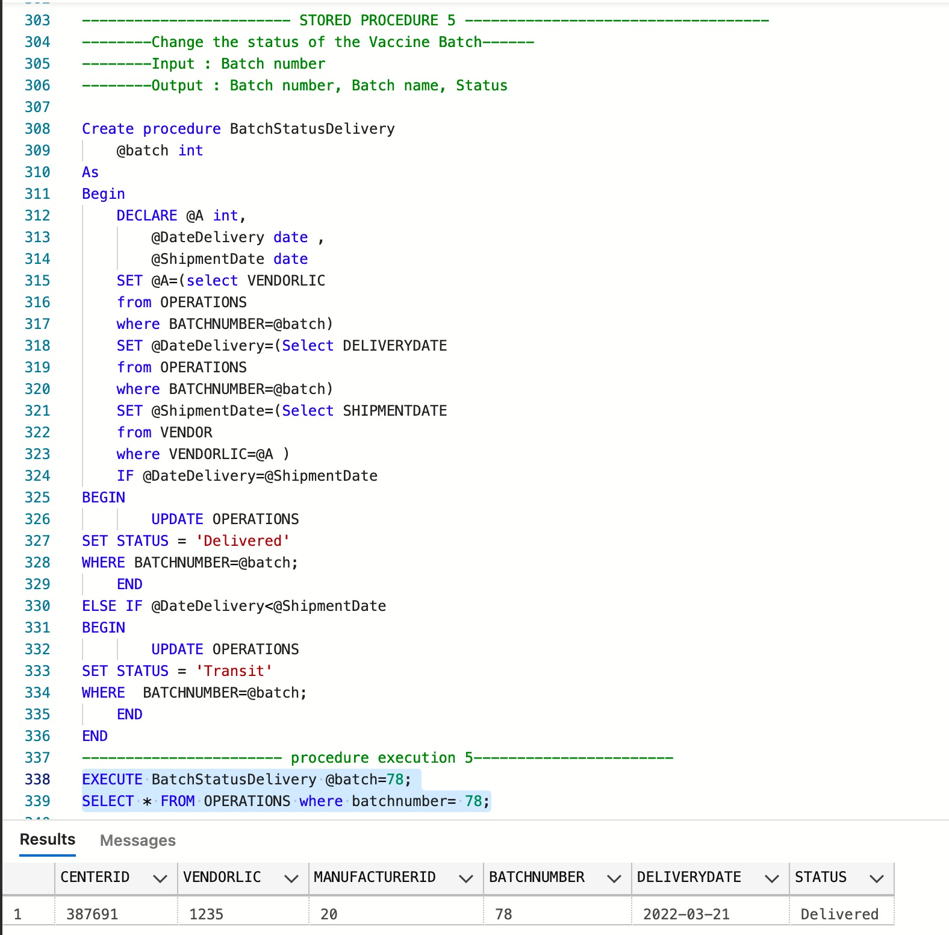
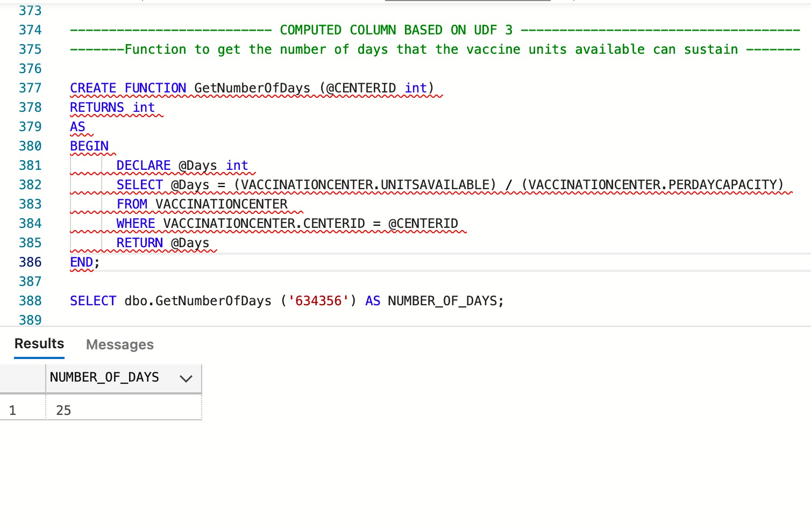
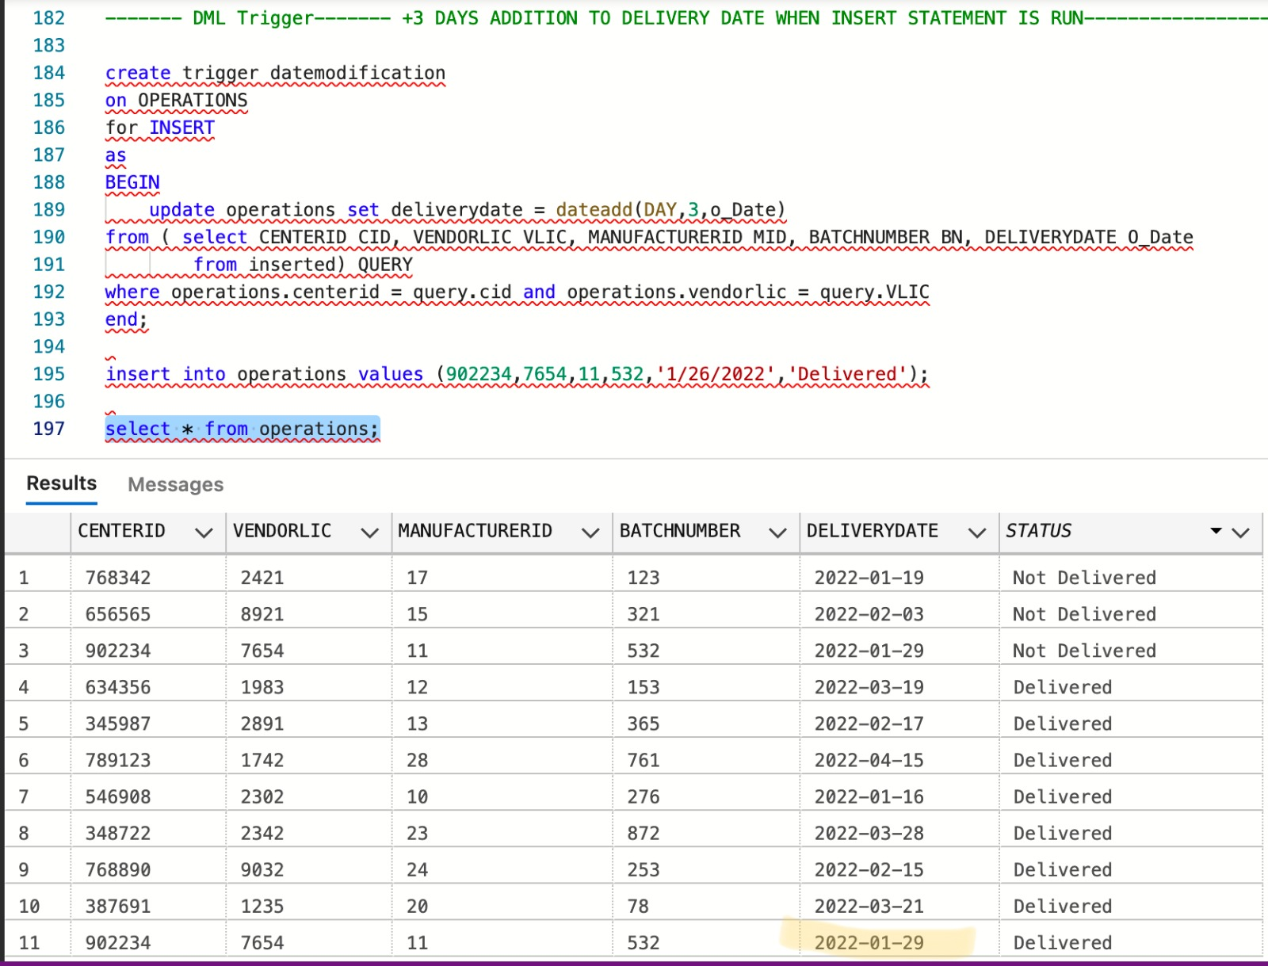
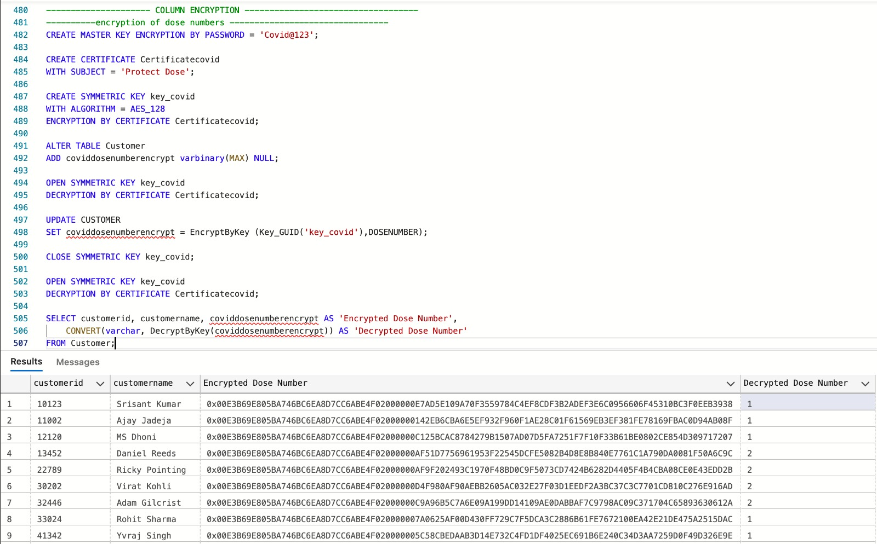
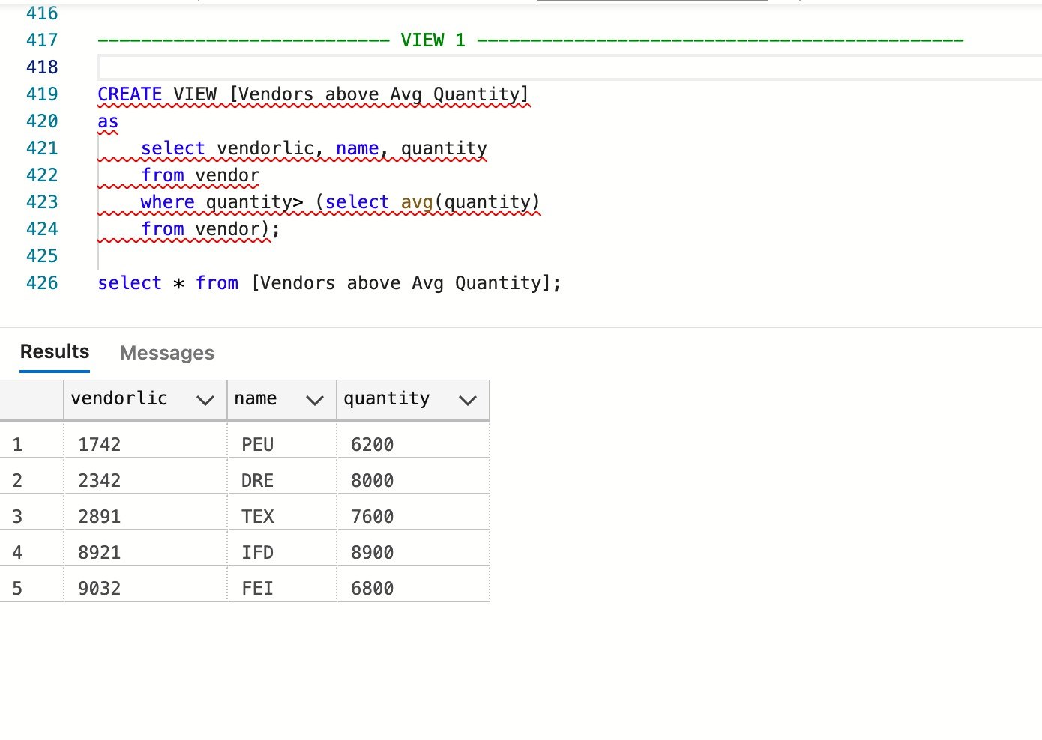
STORED PROCEDURES 1.Get all the customer details based of vaccination date and time 2.Get the vendor information based on vendor ID
3.Update the number of vaccine units based on the availability at a given vaccination center
4.To get the available list of vaccines in a given batch by a given manufacturer
5.To track the status of the vaccine batch and change the status
UDF
1. Number of doses taken by each customer
2. Daily production capacity of manufacturers
3. Quantities of vaccines that the vendors have
4. Number of days that the vaccine units available can sustain
5. Monthly average cost of insurance
Triggers
Encryption
Views

Slide 7
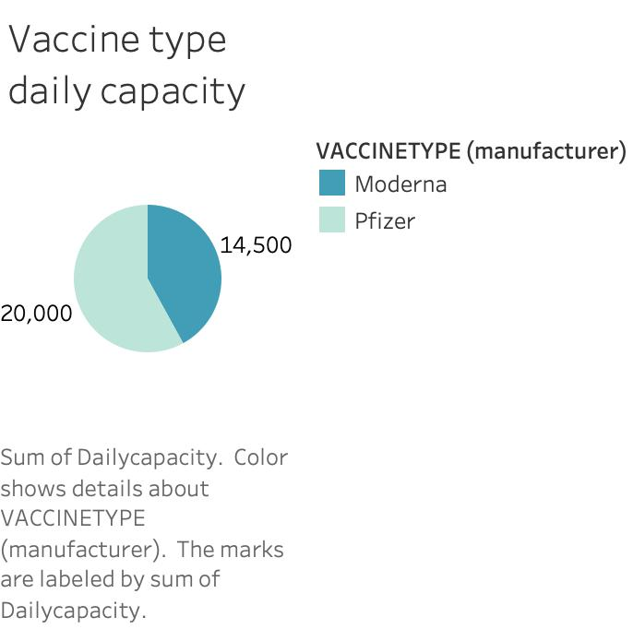
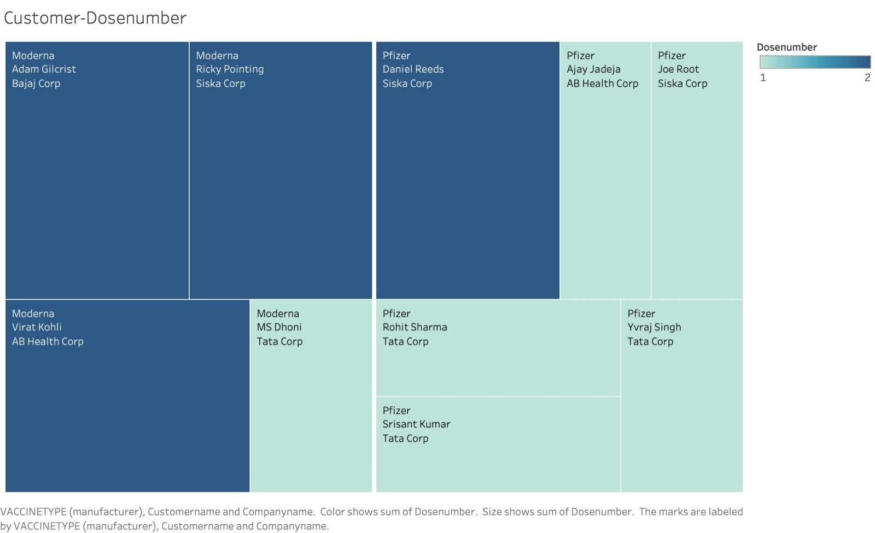
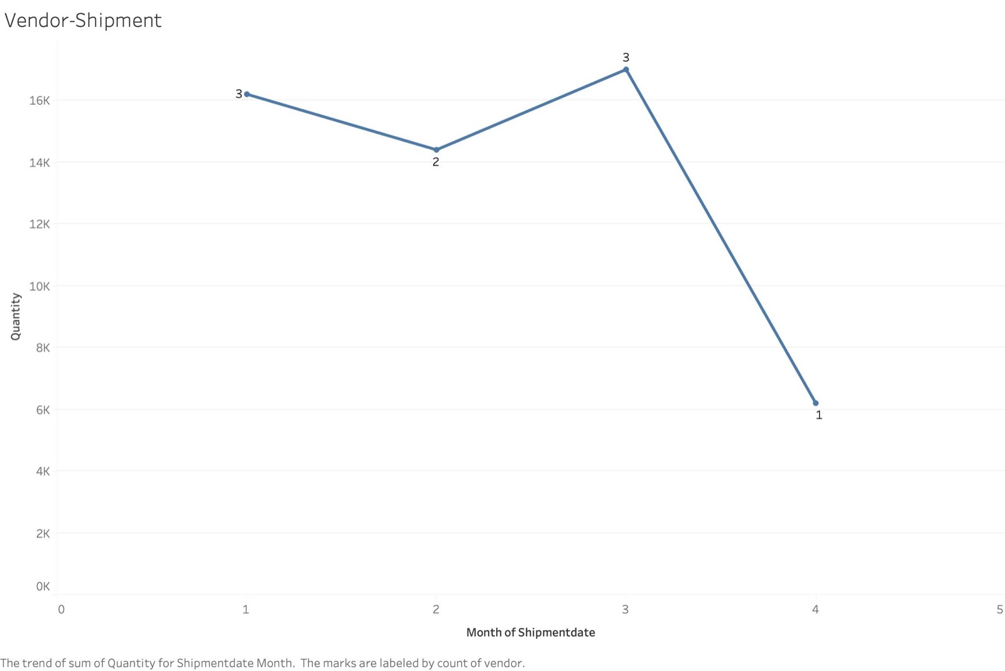
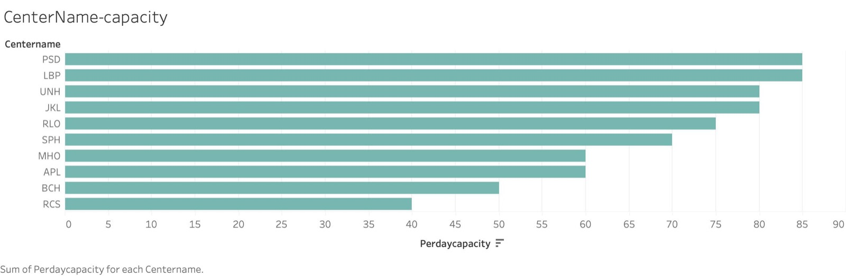
DASHBOARD REPORT

Slide 8
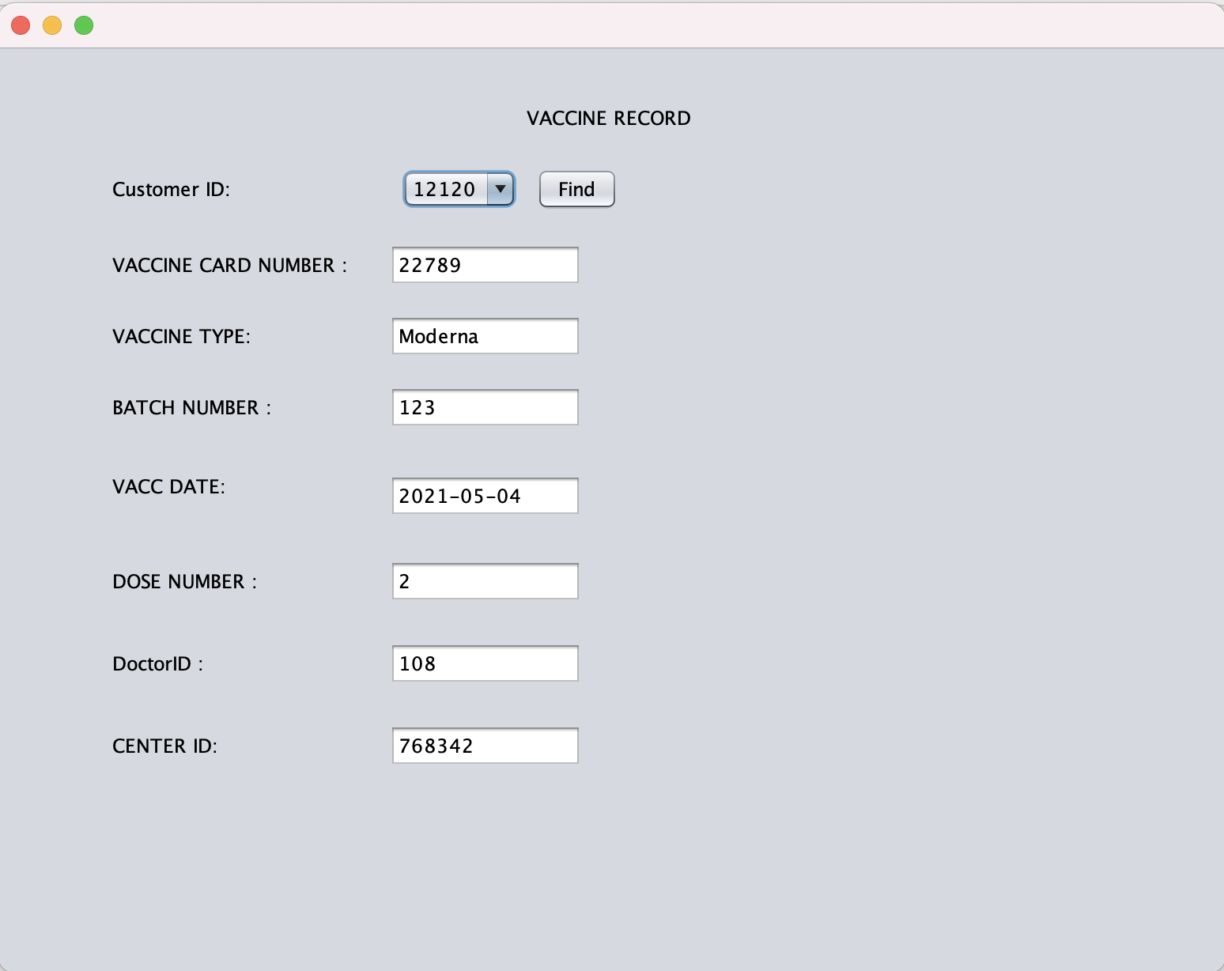
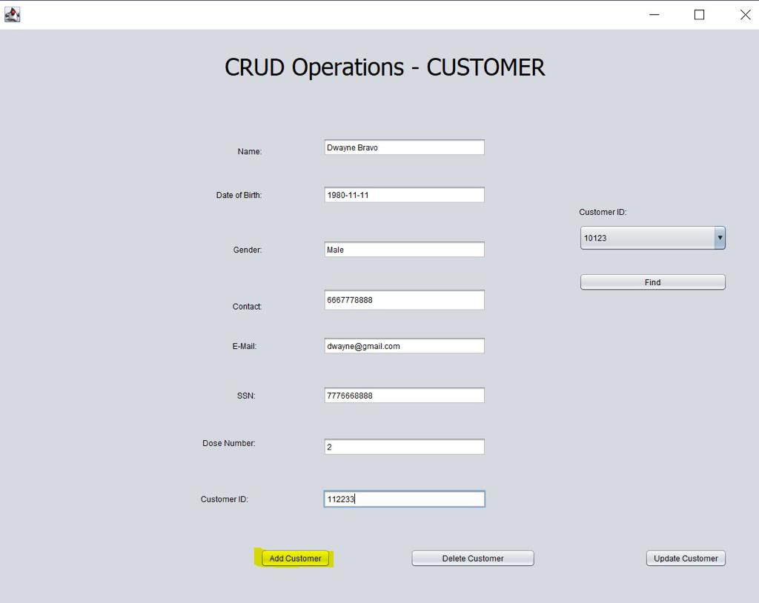
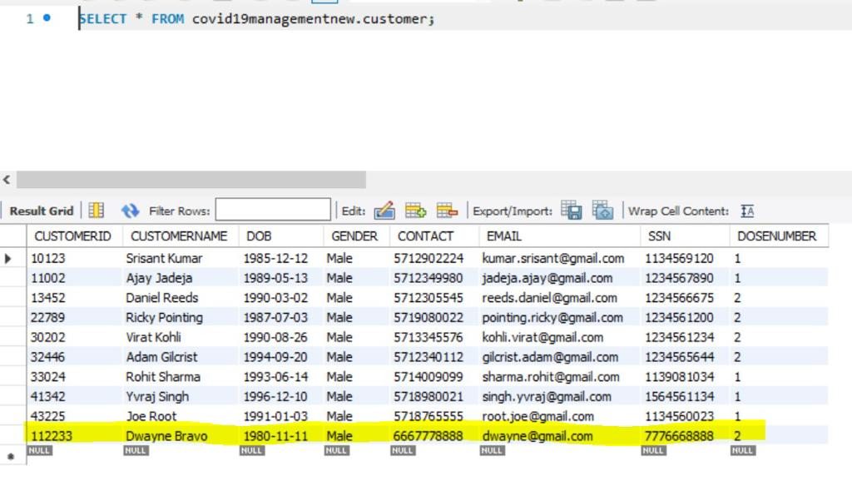
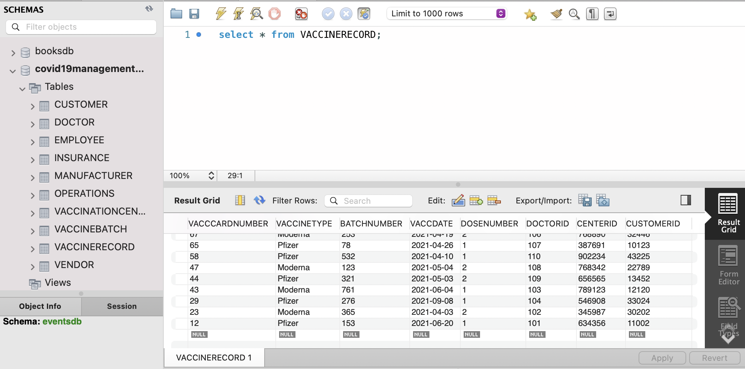
GUI

Slide 9
THANK YOU

